Slide 1
KNN, GMM, & HMM from ML Perspective FDP, Machine Learning, IIIT Dharwad
By
Dr. K. T. Deepak
Assistant Professor
ECE Department
IIIT Dharwad

Slide 2
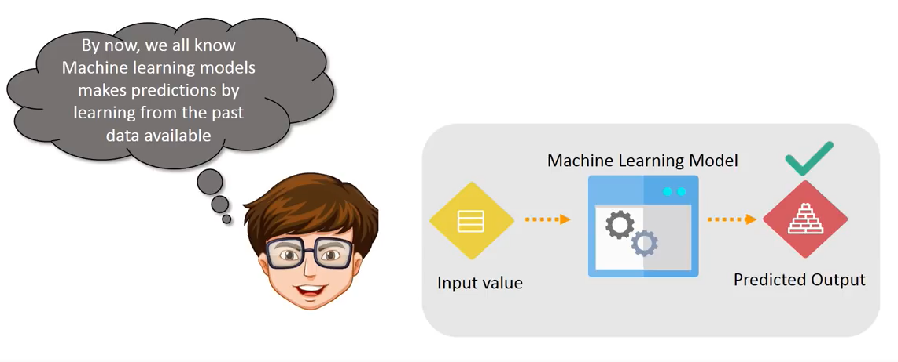
What is Machine Learning?

Slide 3
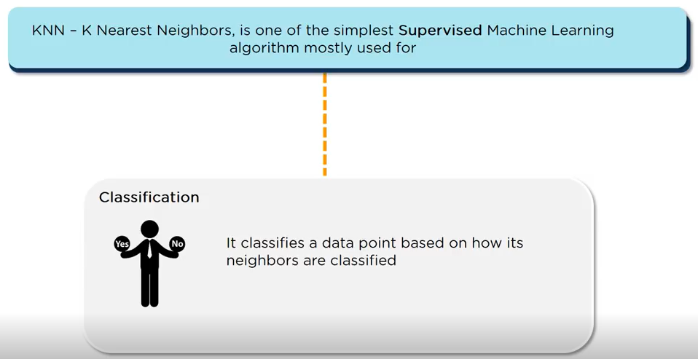
What is KNN Classifier?

Slide 4
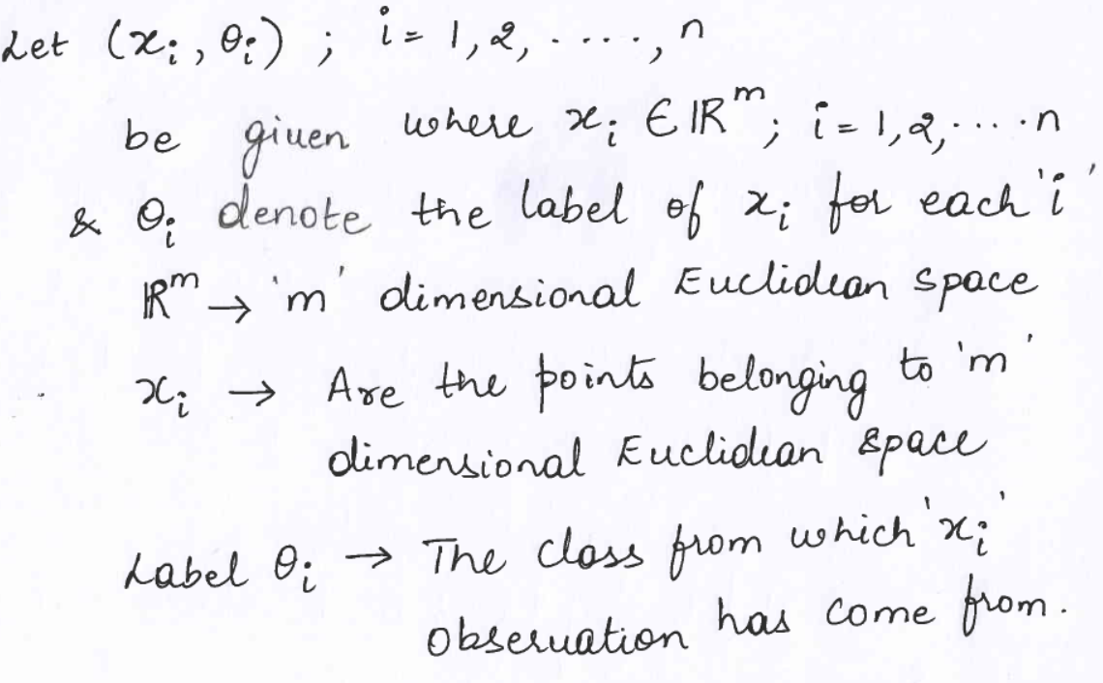
K-Nearest Neighbor Decision Rule

Slide 5
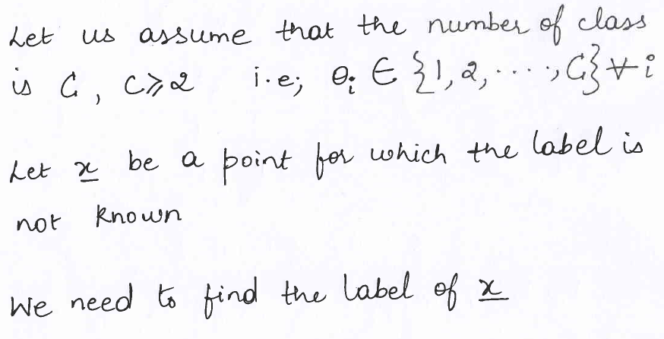
Classes and Labeling

Slide 6
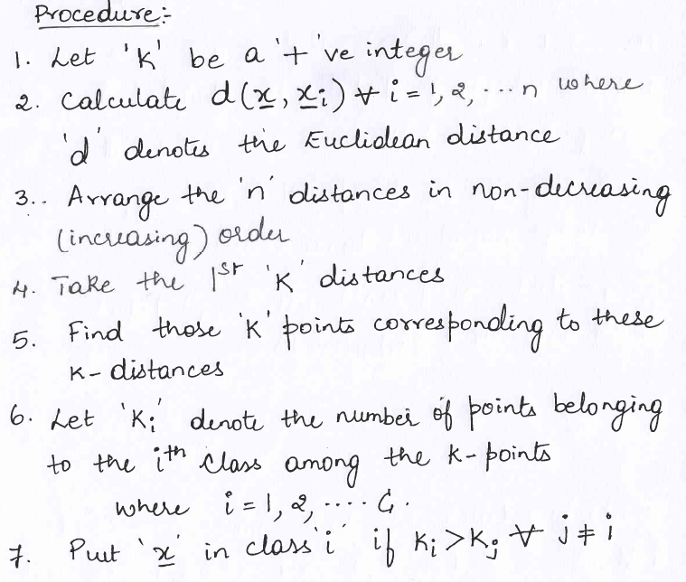
How do we find the Label?

Slide 7
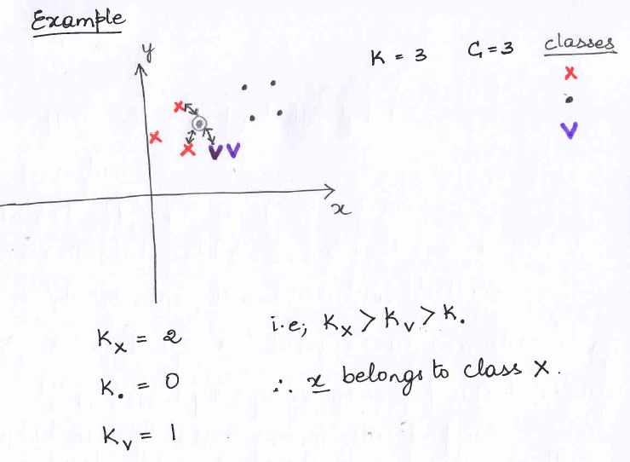
Example of a 2-D Space

Slide 8
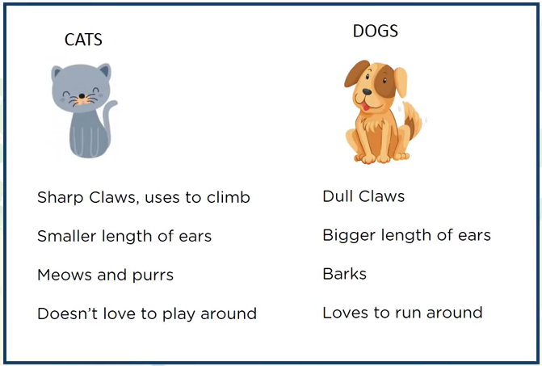
Practical Example of Cats and Dogs

Slide 9
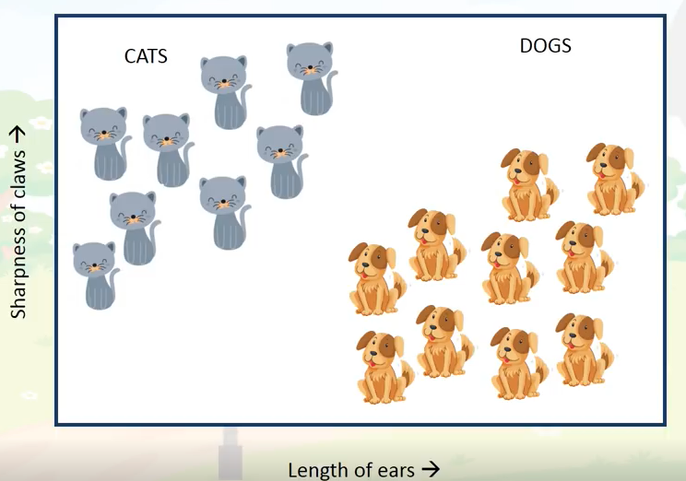
2-D Euclidean Space Feature Representation

Slide 10
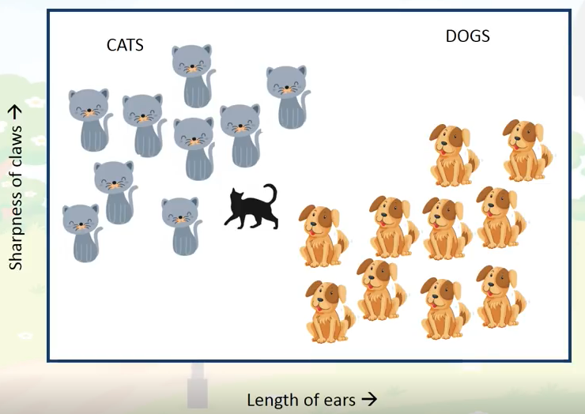
Unknown Test Sample

Slide 11
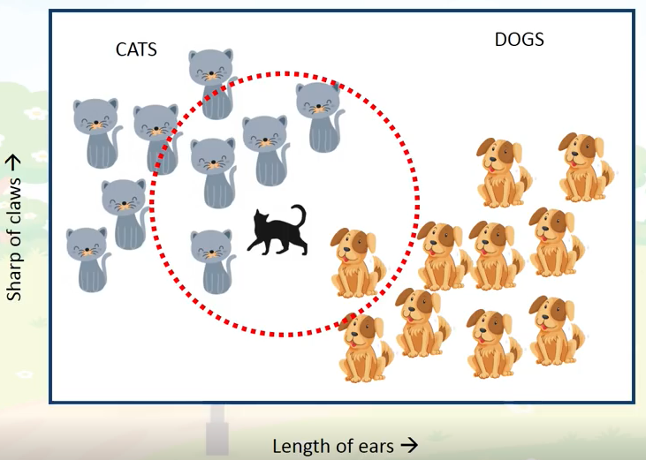
K-NN where K = 5

Slide 12
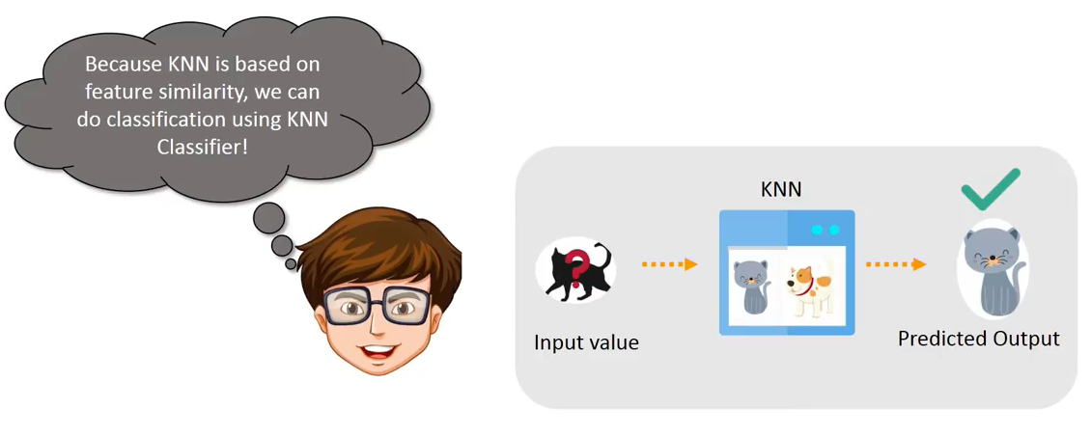
What we did?

Slide 13
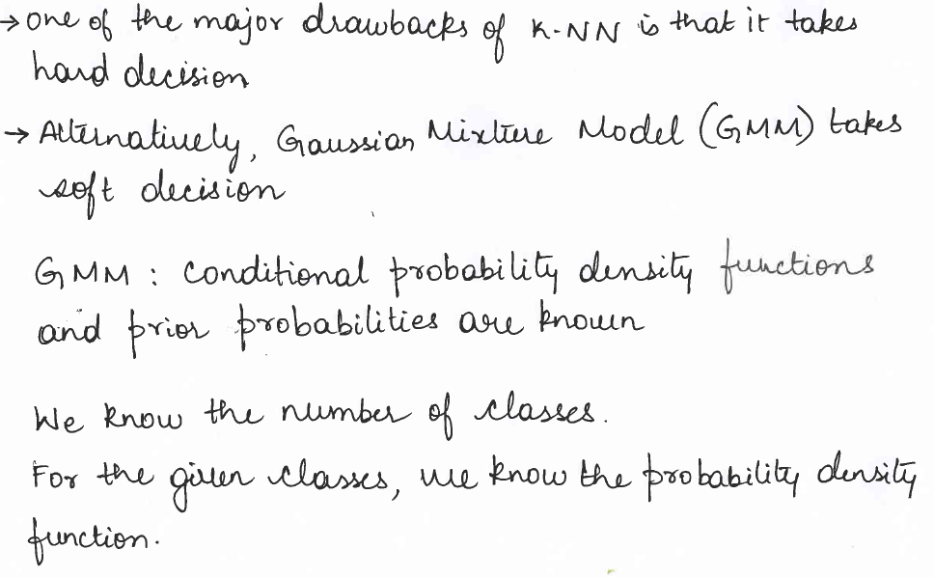
Gaussian Mixture Models (GMM)

Slide 14
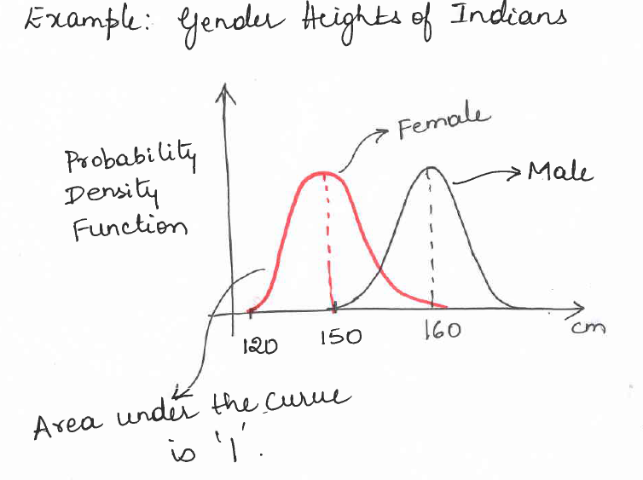
GMM Example 1 - D

Slide 15
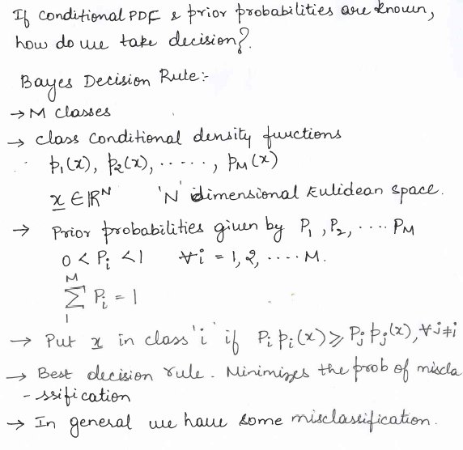
Bayes Decision Rule

Slide 16
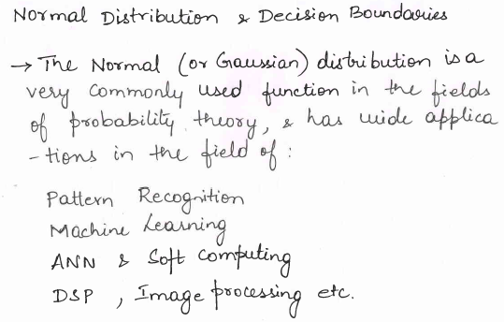
GMM Applications

Slide 17
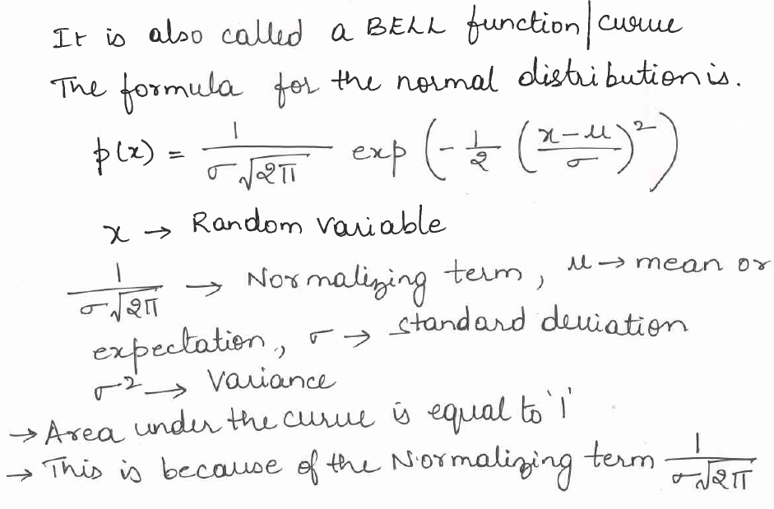
Probability Density Function

Slide 18
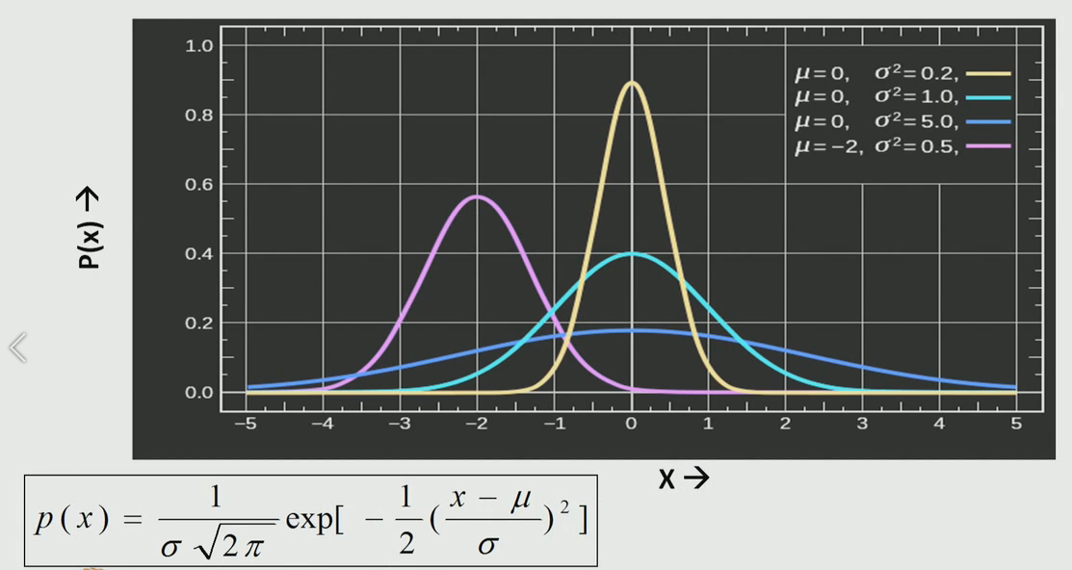
Effect of Mean and Variance

Slide 19
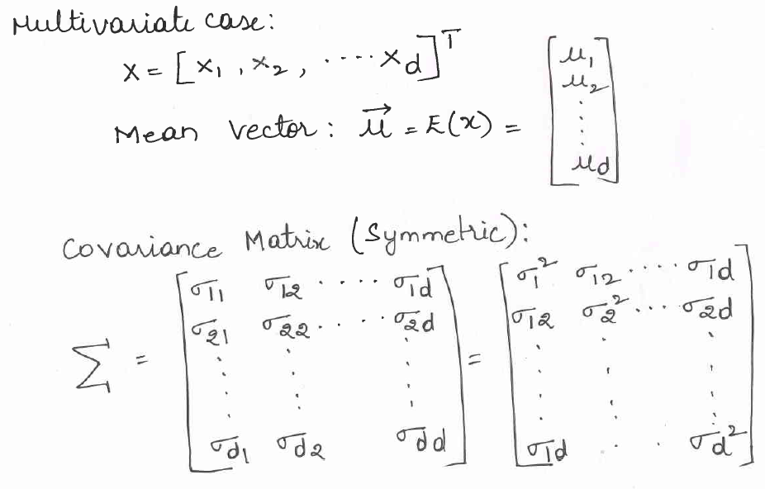
Multivariate Gaussian

Slide 20
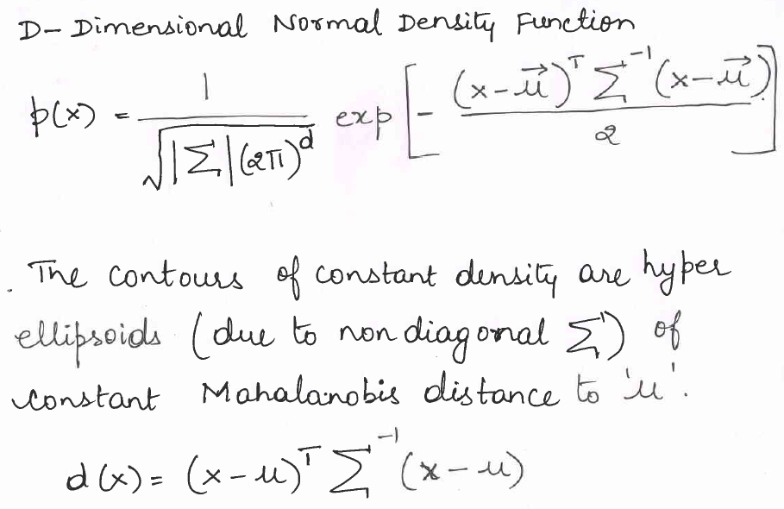
D-Dimensional Normal Density Function

Slide 21
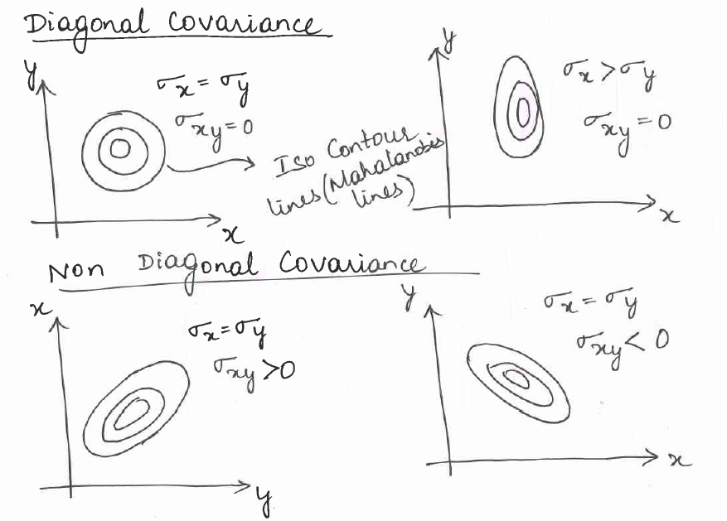
Role of Covariance

Slide 22
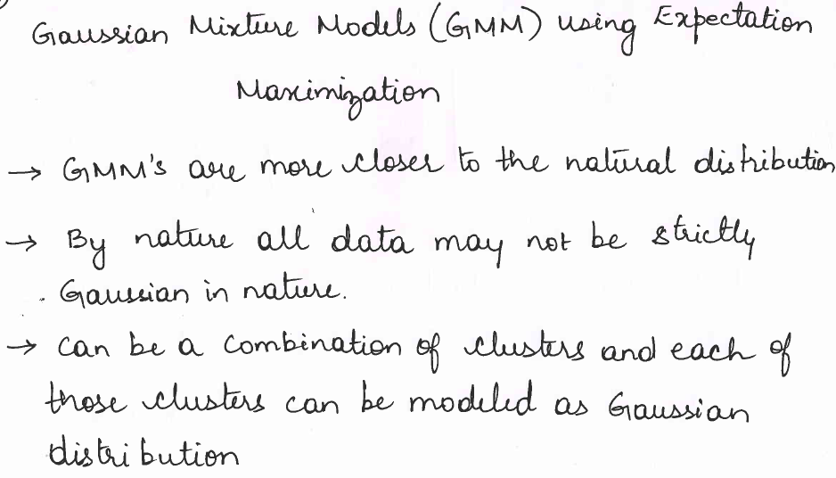
Parameter Estimation

Slide 23
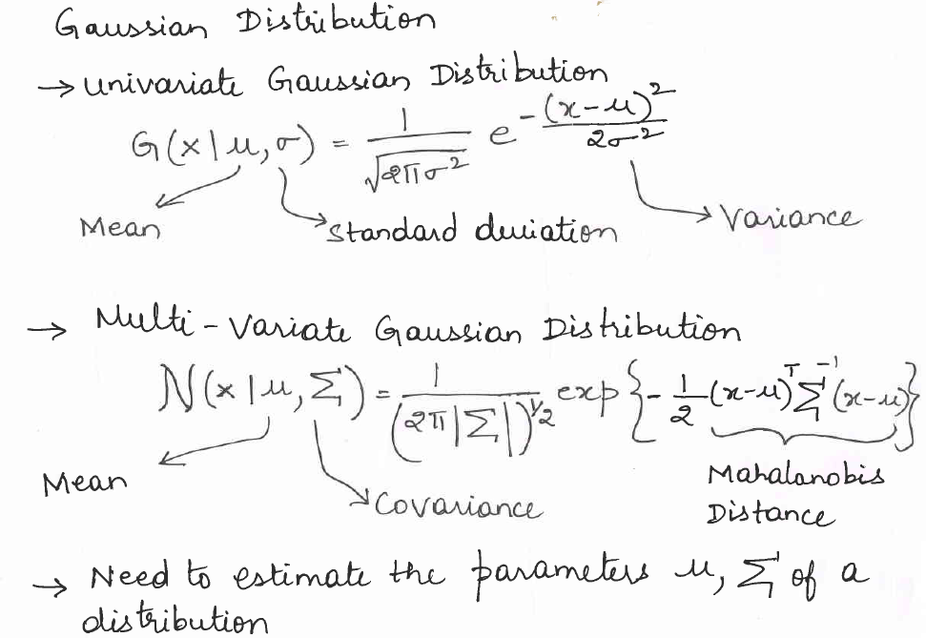
Univariate and Multivariate Gaussian Distribution

Slide 24
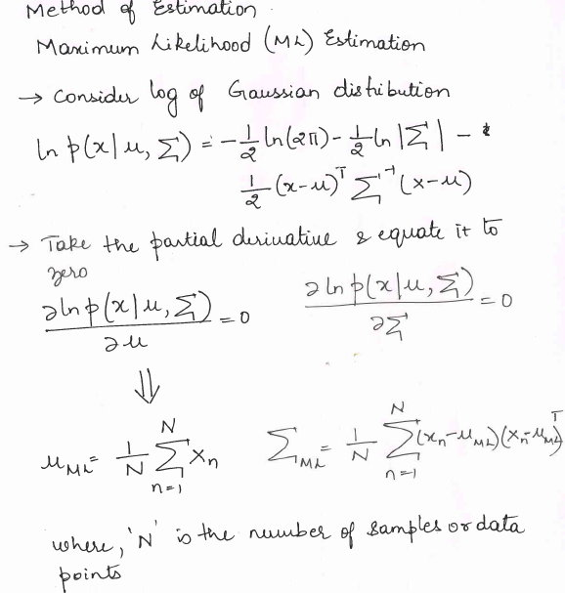
Maximum Likelihood (ML) Estmation

Slide 25
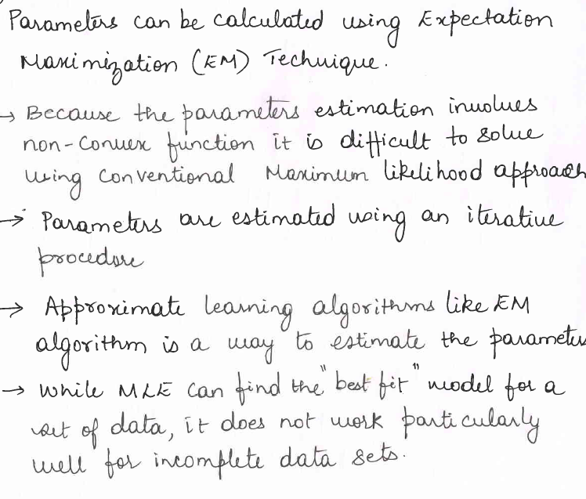
Expectation Maximization

Slide 26
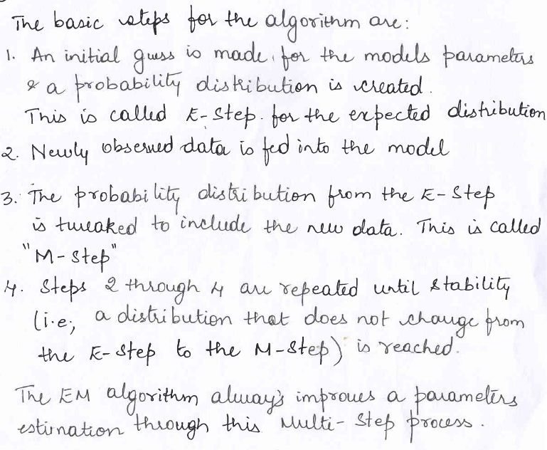
Expectation Maximization Steps

Slide 27
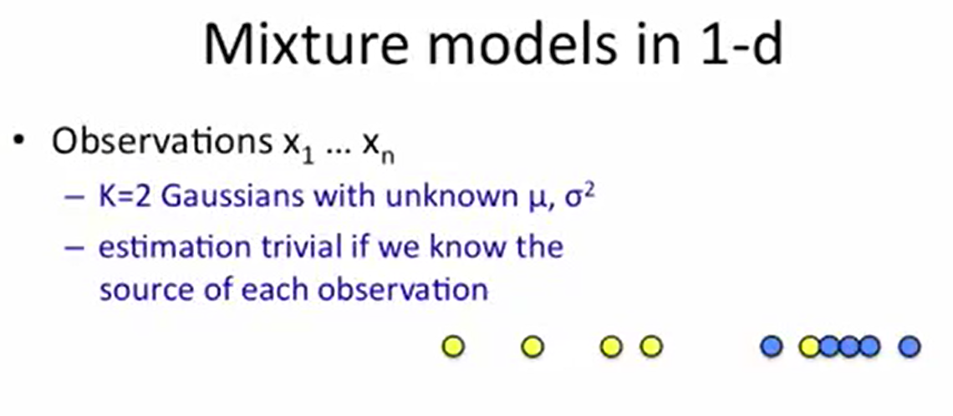

Slide 28
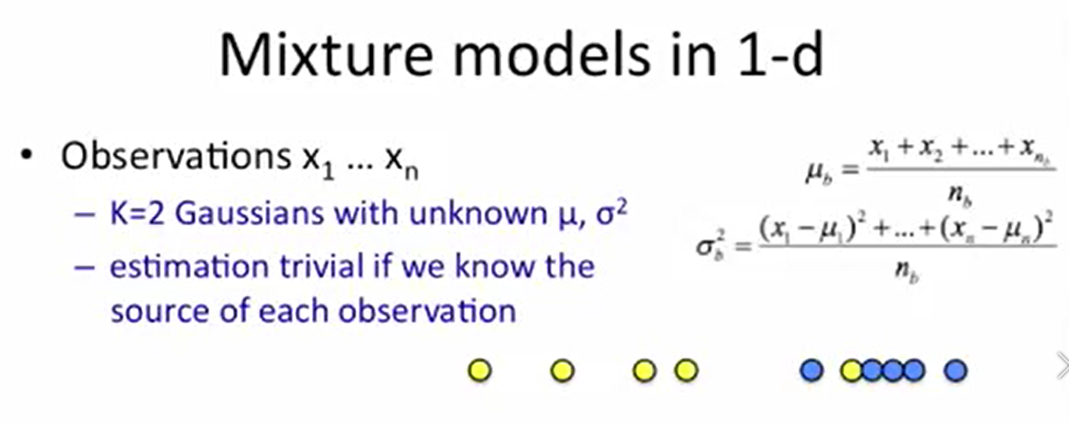

Slide 29
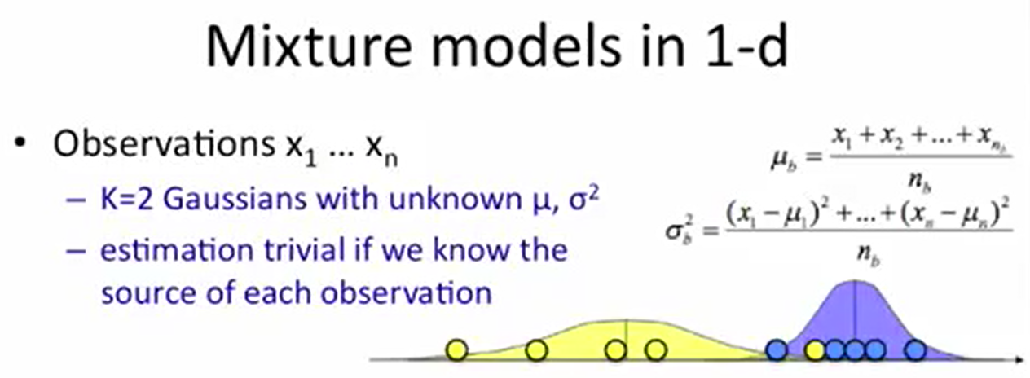

Slide 30


Slide 31
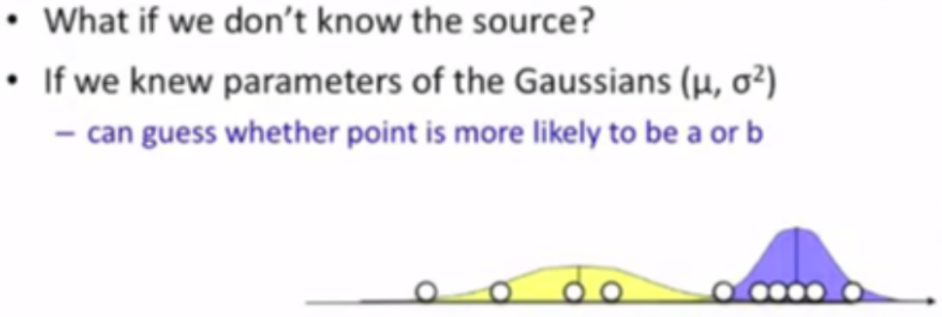

Slide 32
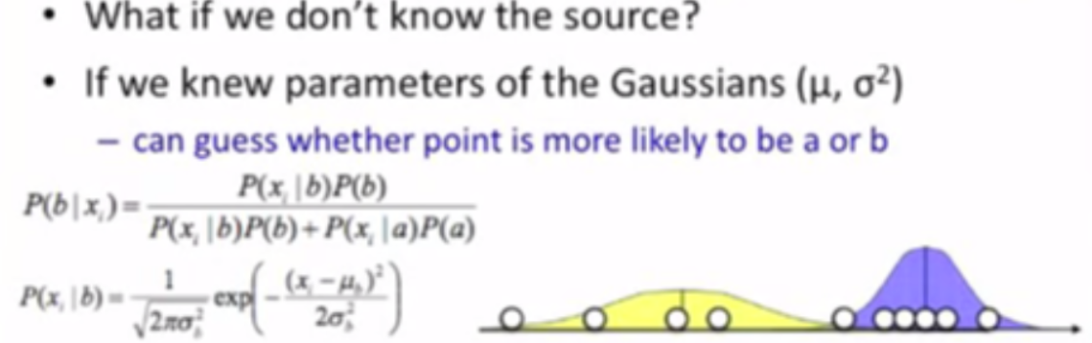

Slide 33
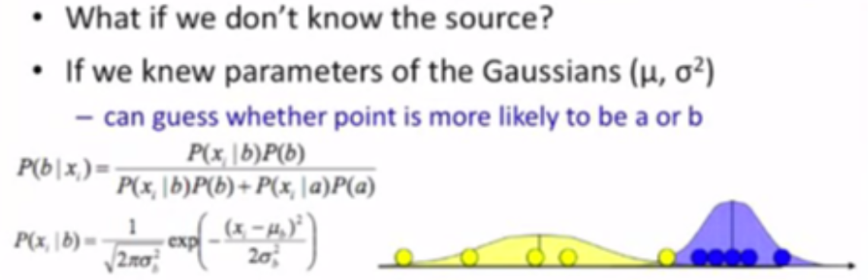

Slide 34
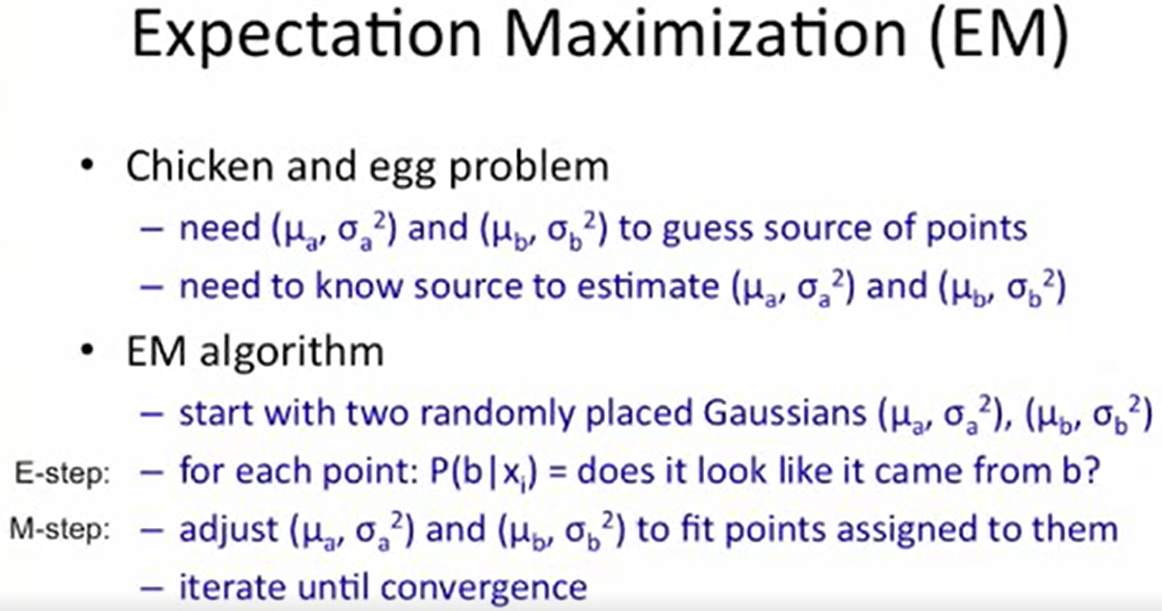

Slide 35
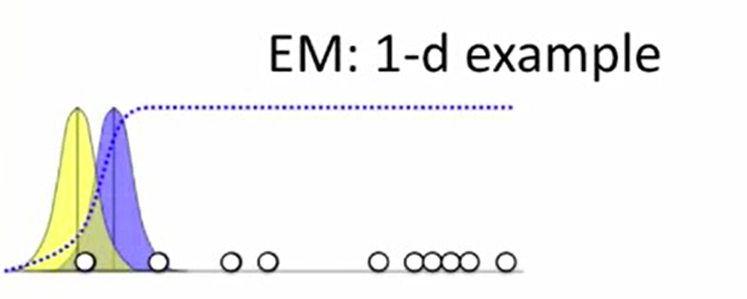

Slide 36
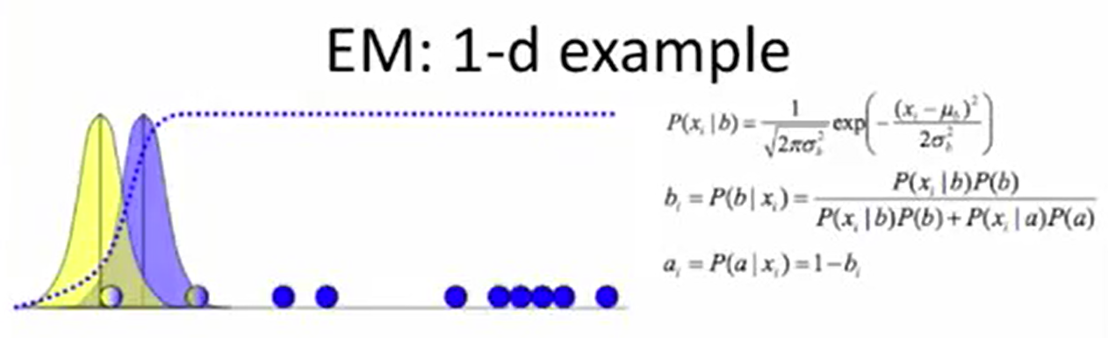

Slide 37
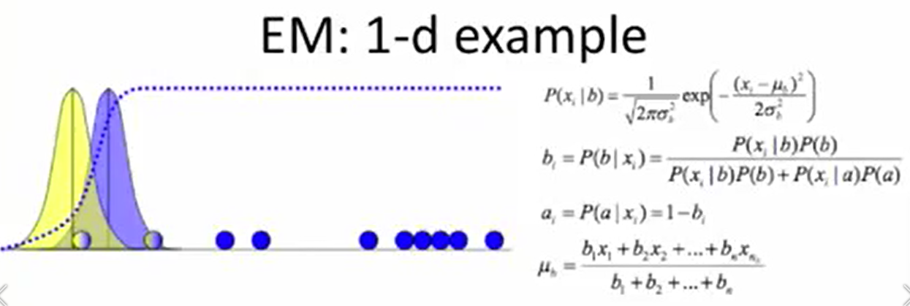

Slide 38
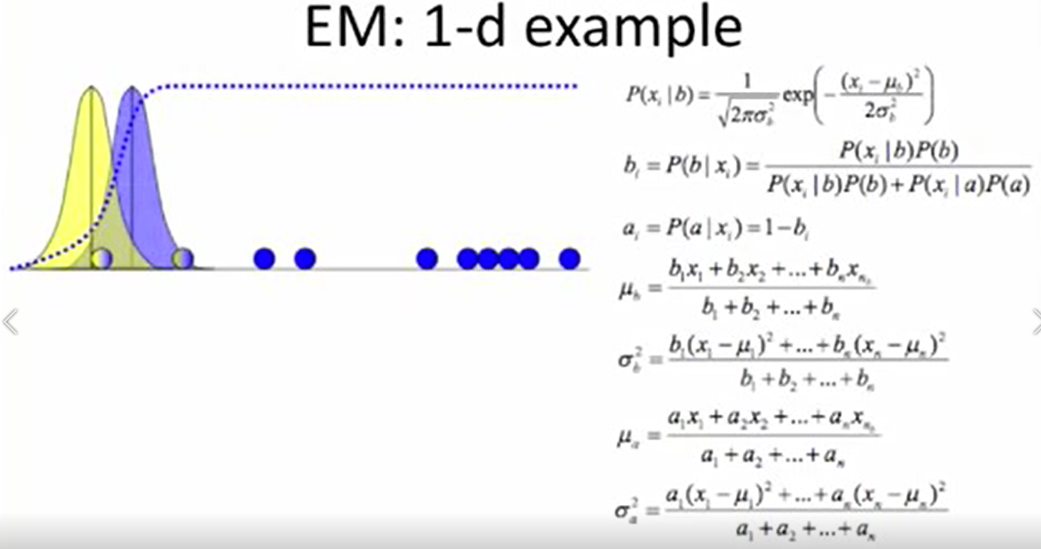

Slide 39
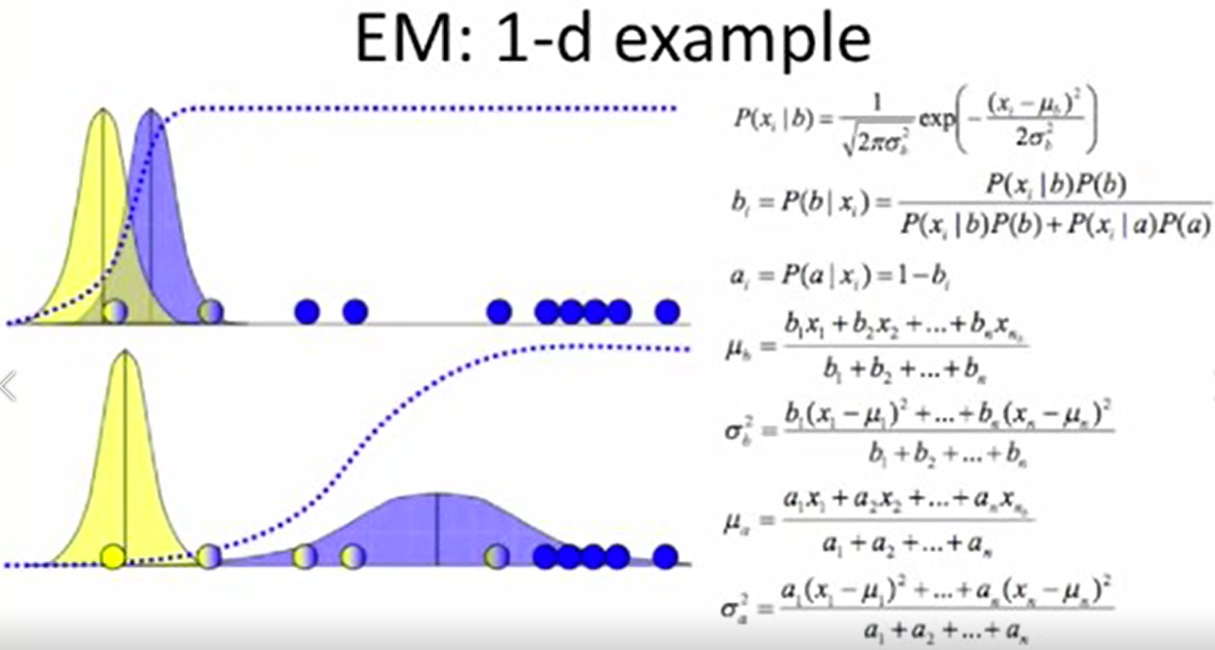

Slide 40
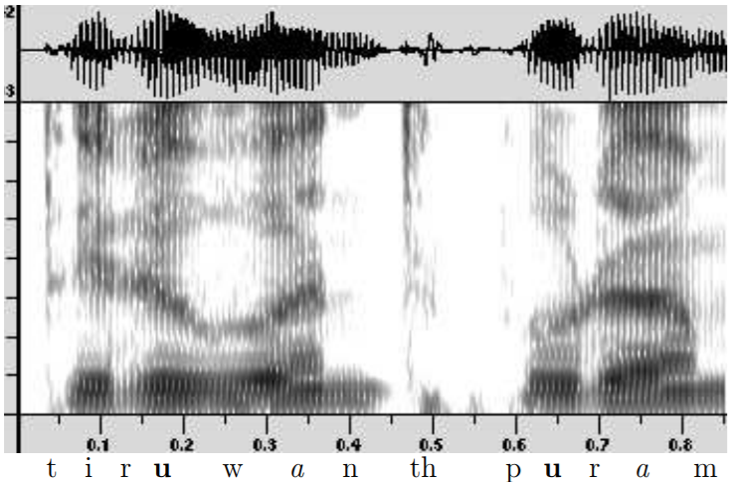
Spectrogram of a Speech Signal

Slide 41
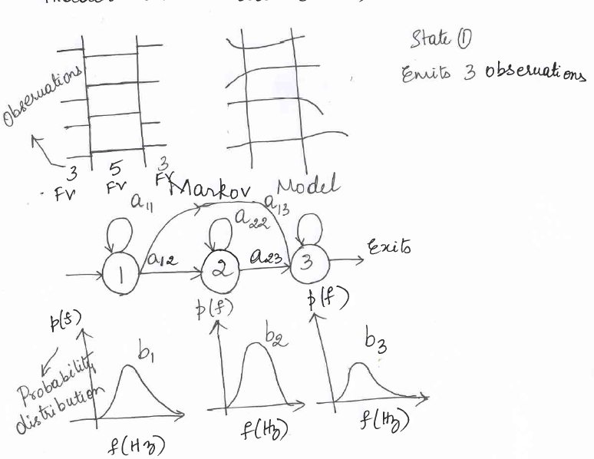
Hidden Markov Model (HMM)

Slide 42
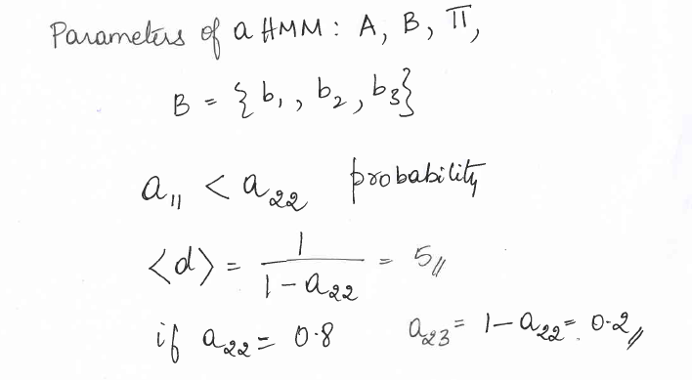
Parameters in HMM

Slide 43
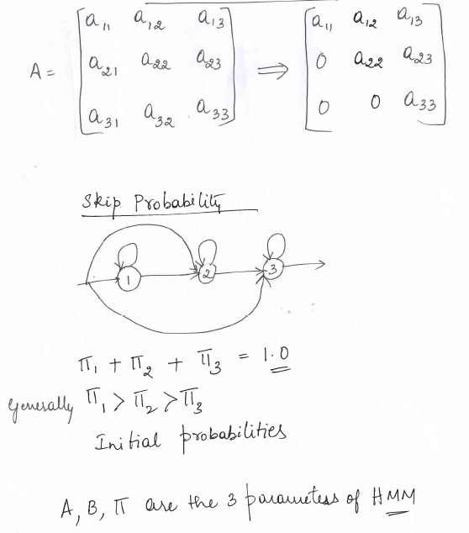
Transition Probabilities

